Slide 1

Python Basics

Slide 2
0
Introduction

Slide 3

What is Python?
Python is a popular programming language which was created by Guido van Rossum, and released in 1991.
It is used for web development, software development, mathematics, Statistics, system scripting, etc.

Slide 4
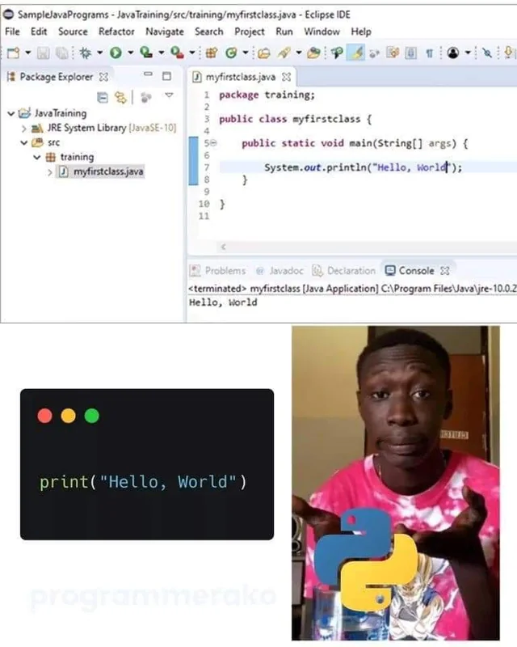
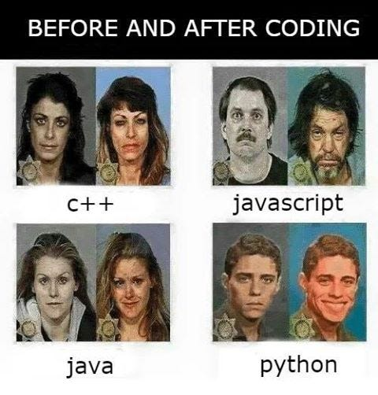
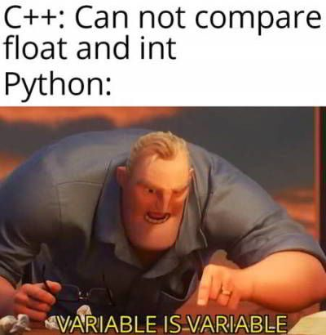
Why Python?

Slide 5
Syntax
Variables
x = 5
y = 'Hello World!'
Comments
# This is a comment.
Indentation
if 5 > 2:
print('Five is greater than two!')

Slide 6
Output and Input
Display output on the screen
print('Hello World!')
print('Hello' + 'World!')
print('Hello', 'World!')
print('Hello', 'World', sep = '-', end = '!')
Take input from user
name = input('Enter your name: ')
print('Hello', name)

Slide 7
1
Variables

Slide 8
Variables
Containers for storing data values
x = 4
x = 'Sally'
print(x)
Assign multiple values
x, y, z = 'Orange', 'Banana', 'Cherry'
One value to multiple variables
x = y = z = 'Orange'

Slide 9
Data Types
Get the type
x = -5j
print(type(x))
Casting
a = str(3)
b = int(3)
c = float(3)
d = bool(3)
Text
Numeric
Sequence
str
int
float
complex
list
tuple
range
Mapping
Set
Boolean
Binary
None
dict
set
frozenset
bool
bytes
bytearray
memoryview
NoneType

Slide 10
Numbers
Three numeric types
a = 1 # int
b = 2.8 # float
c = 1j # complex
Functions
min() max() abs()
Operators
+ - * / % ** //

Slide 11
Strings
Single line and multiline string
a = 'Hello!'
b = '''Hello!
How are you?'''
F-strings
name, age = 'Alireza' , 24
message = f'Hello {name}, you are {age} years old!'
Operators
+ *

Slide 12
Booleans
True or False
a = True
b = False
c = 10 >= 9
d = 10 == 9
e = 10 > 9 and 2 + 2 == 5
e = 10 > 9 or 2 + 2 == 5
f = not 2 + 2 == 5
Operators
< <= > >= == != and or not

Slide 13
Collections
Lists
fruits = ['apple', 'banana', 'cherry']
Tuples
fruits = ('apple', 'banana', 'cherry')
Sets
fruits = {'apple', 'banana', 'cherry’}
Dictionaries
fruits = {'apple': 'green', 'banana': 'yellow', 'cherry': 'red'}

Slide 14
Lists
Ordered, changeable, and allow duplicate values
fruits = ['apple', 'banana', 'cherry', 'apple', 'cherry']
print(fruits[0], fruits[-3], fruits[1:3], fruits[:-1], fruits[0:-1:2], fruits[::-1])
print('orange' in fruits)
print(len(fruits))
Update Lists
fruits[3] = 'orange'
fruits.append('kiwi')
fruits.remove('banana')
fruits.pop(3)

Slide 15
Tuples
Ordered, unchangeable, and allow duplicate values
fruits = ('apple', 'banana', 'cherry', 'apple', 'cherry')
print(fruits[0], fruits[-3], fruits[1:3], fruits[:-1], fruits[0:-1:2], fruits[::-1])
print('orange' in fruits)
print(len(fruits))
Update tuples
fruitsList = list(fruits)
fruitsList[3] = 'orange'
fruitsList.remove('banana')
fruits = tuple(fruitsList)

Slide 16
Sets
Unordered, unchangeable, and no duplicate values
fruits = {'apple', 'banana', 'cherry'}
print('orange' in fruits)
print(len(fruits))
Update sets
fruits.add('orange')
fruits.remove('banana')
fruits.pop()

Slide 17
Join Sets
Join Sets
students = {'Ali', 'Zahra', 'Bahram'}
workers = {'Zahra', 'Bahram', 'Nahid'}
allMembers = students.union(workers)
wortudents = students.intersection(workers)
notWortudents = students.symmetric_difference(workers)
nonworkingStudents = students - workers
nonstudentWorkers = workers - students

Slide 18
Dictionaries
Ordered, changeable, and no duplicate values
fruits = {'apple': 'green', 'banana': 'yellow', 'cherry': 'red'}
print(fruits['apple'])
print('orange' in fruits)
print(len(fruits))
print(fruits.keys())
print(fruits.values())
Update Dictionaries
fruits['apple'] = 'red'
fruits['kiwi'] = 'green'
fruits.pop('banana')

Slide 19
2
Conditions

Slide 20
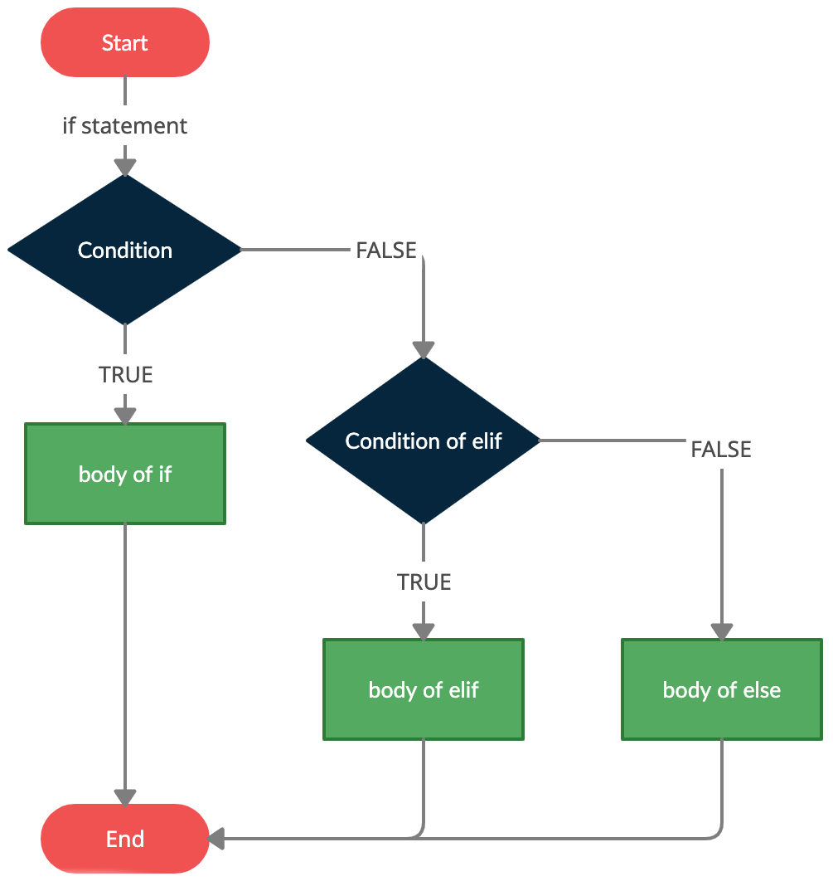
If Statements
If statement
a, b = 200, 100
if a > b:
print('a')
elif a < b:
print('b')
else:
print('=')
Shorthand if statement
a, b = 200, 100
print('a') if a > b else print('b') if a < b else print('=')

Slide 21
Nested If Statements
Nested if
score = 18
if score >= 10:
print('Pass')
if score >= 18:
print('with grade A!')
elif score >= 15:
print('with grade B!')
elif score >= 12:
print('with grade C!')
else:
print('with grade D!')
else:
print('Fail!')

Slide 22
Match Case
Switch statement
language = input('What is the programming language you want to learn? ')
match language:
case 'JavaScript':
print('You can become a web developer.')
case 'Python':
print('You can become a Data Scientist.')
case 'PHP':
print('You can become a backend developer.')
case 'Solidity':
print('You can become a Blockchain developer.')
case _:
print('The language doesn't matter, what matters is solving problems.')

Slide 23
3
Loops

Slide 24
While Loops
Execute a set of statements as long as a condition is true
i = 1
while i < 10:
print(i)
i += 1
else:
print(f'Finished after {i} loops')

Slide 25
For Loops
Iterating over a collection
for fruit in ['apple', 'banana', 'cherry']:
print(fruit)
else:
print('Finished!')
Iterating over a string
for letter in 'apple':
print(letter)
Looping Through a Range
for number in range(20):
print(number)
for number in range(5, 20):
print(number)
for number in range(5, 20, 2):
print(number)

Slide 26
Break and Continue
Break and continue
for i in range(10):
if i == 2:
continue
if i == 5:
break
print(i)
else:
print(f'Finished after {i} loops')

Slide 27
Nested Loops
Nested while and for loops
number = 2
adjectives = ['big', 'tasty']
fruits = ['apple', 'banana', 'orange']
while number < 5:
for adjective in adjectives:
for fruit in fruits:
print(f'{number} {adjective} {fruit}s')
number += 1

Slide 28
4
Functions

Slide 29
Functions
Blocks of code which only run when they are called
def greeter():
print('Hello!')
greeter()
Arguments and return
def greeter(firstName, lastName):
greeting = f'Hello {name}!'
return greeting
message = greeter('Alireza', 'Nezhadshamsi')
print(message)

Slide 30
Functions
Keyword arguments
def greeter(firstName, lastName):
return f'Hello {firstName} {lastName}!'
print(greeter(lastName = 'Nezhadshamsi', firstName = 'Alireza'))
Default parameter value
def greeter(firstName = 'dear', lastName = 'user'):
return f'Hello {firstName} {lastName}!'
print(greeter('Alireza', 'Nezhadshamsi'))

Slide 31
Functions
Type Annotations
def fullName(firstName: str, lastName: str) -> str:
return f'{firstName.title()} {lastName.title()}'
print(fullName('Alireza', 'Nezhadshamsi'))
Recursion
def factorial(number):
return number * factorial(number - 1) if number > 1 else 1
print(factorial(4))

Slide 32
Lambda
Small anonymous functions
greeter = lambda: print('Hello')
print(greeter())
Arguments
greeter = (lambda name = 'dear user': f'Hello {name}!')
print(greeter(name = 'Alireza'))

Slide 33
Lambda
Single Expression
(lambda x: (x % 2 and 'odd' or 'even'))(7)
Nested lambda
funcPlus = lambda x, func: x + func(x)
print(funcPlus(5, lambda x: x * x))

Slide 34
5
Errors

Slide 35
Try Except
Test a block of code for errors and handle the error
try:
print(x)
except NameError:
print('Variable x is not defined')
except:
print('Something else went wrong')
else:
print('Nothing went wrong')

Slide 36
Exceptions
Handle the error
try:
print(x)
except Exception as e:
print(e)
Raise an error
x = -1
if x < 0:
raise Exception('Please enter a positive number')

Slide 37
6
Modules

Slide 38
Modules
A module is a file containing a set of functions you want to include in your application.
To create a module just save the code you want in a file with the file extension .py.
Python module index: https://docs.python.org/3/py-modindex.html
Using a module
import myModule as m
m.greeter('Alireza') # Functions
importedName = m.name # Variables
Import from a module
from mymodule import greeter, name

Slide 39
Packages
A package contains all the files you need for a module.
PIP is a package manager for Python packages, or modules if you like.
Python package index: https://pypi.org/
Download a package
pip install numpy
Remove a package
pip uninstall numpy
List packages
pip list

Slide 40
Datetime
Import and use datetime
import datetime
now = datetime.datetime.now()
print(now)
myBirthday = datetime.datetime(1999, 1, 5)
print(myBirthday.strftime('%x'))
print(myBirthday.strftime('%A'))
print((now - myBirthday).days)

Slide 41
Math
Import and use math
import math
print(math.sqrt(64))
print(math.ceil(1.4))
print(math.floor(1.4))
print(math.exp(5))
print(math.factorial(5))
print(math.log(5))
print(math.pi)
print(math.e)

Slide 42
JSON
JSON is a syntax for storing and exchanging data.
Import and use math
import json
myJson = '{ "name": "Alireza", "age": 24 }'
myDict = json.loads(x)
myDict['age'] = 29
anotherJson = json.dumps(x)
String
Number
Array
str
int
float
list
tuple
Object
Boolean
Null
dict
bool
NoneType

Slide 43
Requests
Import and use math
import requests
response = requests.get('https://fipiran.com', timeout = 1)
print(response)
print(response.status_code)
print(response.encoding)
print(response.text)

Slide 44
Thanks!
You can find me at:
github.com/AleeRezaa
t.me/Alee_Rezaa
alee_rezaa@outlook.com

